Slide 1

DEPARTMENT OF MECHANICAL ENGINEERING GOVERNMENT POLYTECHNIC PUNE (2020-21) INPLANT – TRAINING REPORT Name – Atharva Londhe Enrollment No. – 1904081 Mentor – Mr. Chandrakant Ghadge

Slide 2
Industry Details
Name - Strama-Summit Machinery Pvt. Ltd.
Headquarters – Nashik
Type of Industry - Manufacturing , Exporter , Automation
Founded on – 1946
Address – Plot No. F-93 , Near Kaso , MIDC Ambad
Nashik - 422011.
Phone No. - +91-8237074417
Email – ravi.mahadeokar@stramasummit.com
CEO / CMD – Mr. Ravi Mahadeokar
Area Served – India
Website – www.stramasummit.com
Total No. of Employees – 70
Sales Turnover – 50Lakh – 1 Cr

Slide 3
Product portfolio of Strama -Summit Pvt. Ltd
Some of their products are as follows
Cleaning technology:
- RoboClean
- LeanClean
Assembly and testing technology:
- ProMoChangeA
- ProMoScriptA
- ProMoScriptA compact
- ProMoCell – Standard assembly cell
Body welding and assembly systems:
- Welding plant for passenger car front modules
- Spot welding plant assembly – rear end
- Jig and Fixture making
- Equipment setup

Slide 4
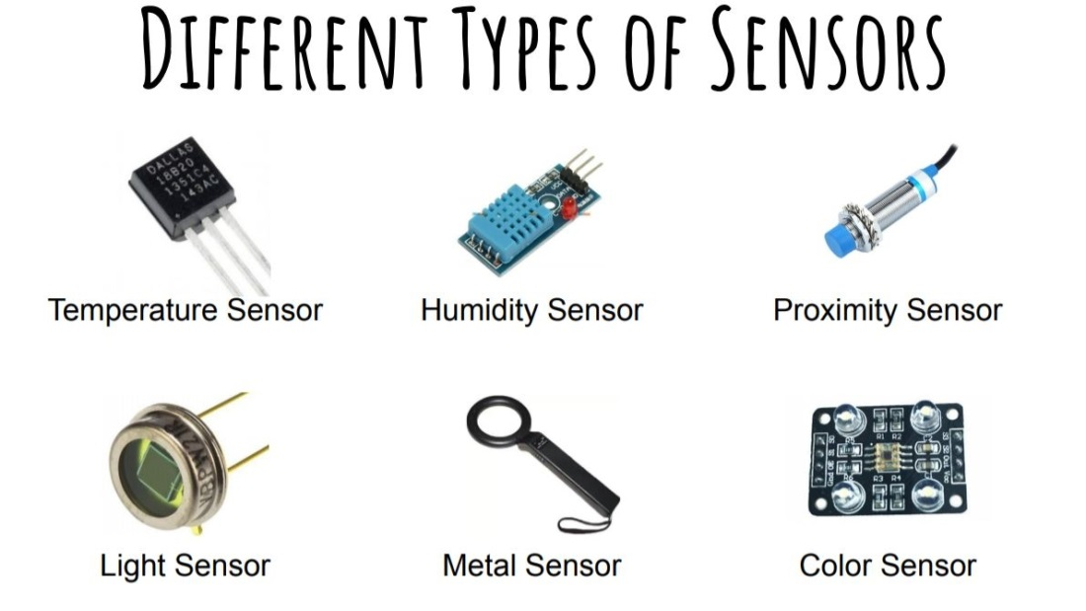
Topic – Sensor Technology
Sensor: It is a device which detects or measures a physical property and
records, indicates, or otherwise responds to it.
Different Types of Sensors :
Temperature Sensor.
Proximity Sensor.
Accelerometer.
IR Sensor (Infrared Sensor)
Pressure Sensor.
Light Sensor.
Ultrasonic Sensor.
Smoke, Gas and Alcohol Sensor
Selection criteria for sensors:
Accuracy
Stability
Environmental Conditions
Range
Calibration
Resolution
Cost
.Power Consumption
Repeatability

Slide 5
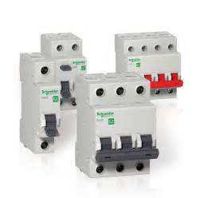
Topic – Switchgears
Switchgears: Device used to control, regulate or switch the circuit.
Types of Switchgears:
1. MCB: (Miniature Circuit Breaker): It is used for safety
concerned when current exceeds than the required.
2. MCCB: (Moulded Case Circuit Breaker): When current
is exceeds than the MCB, MCCB is used.
3 . MPCB: (Motor Protection Circuit Breaker): Current Can
be adjustable in this circuit. We can define current
between two parameters.
4. Relays: It is a switch that opens and closes the circuit
5. Contactors: It is another type of relays used for
switching large amount of electrical power.
6. OLR: It works like MCB. When load in circuit exceeds
preset value it opens the switch.
Timer: It provide delays to the process.
1. On delay
2. Off delay
3. Interval on delay and off delay

Slide 6
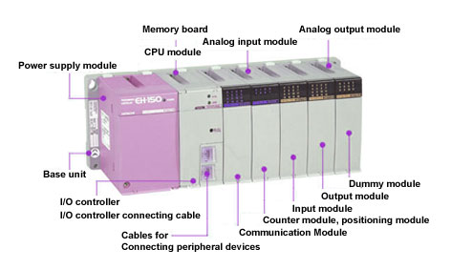
Topic – Basic PLC
PLC – A programmable logic controller (PLC) is an industrial
computer control system that continuously monitors the state of
input devices and makes decisions based upon a custom
program to control the state of output devices.
PLC applications :
1. Robots manufacturing and control
2. Train control station system
3. Food Processing
4. Material handling
5. Conveyor system
Leading brands of PLC :
1. Allen Bradley – USA
2. Siemens – Germany
3. Mitsubishi – Japan
4. Schneider Electric – France
5. ABB – Germany

Slide 7
Languages of PLC :
1. Ladder
2. Structural
3. Sequential Flow Chart
4. Functional block diagram
Types of PLC (size):
1. Small – 128 I/O’s and memory upto 2 Kbytes
2. Medium – 2048 I/O’s and memory upto 32 Kbytes
3. Large – 8192 I/O’s and memory upto 750 Kbytes
Major components of PLC:
1. Input modules
2. Power supply
3. Processor
4. Programming device
Output modules
Selection criteria for PLC:
1 . Number of logical input and output
2. Memory
3. Number of special I/O modules
4. Communication Software

Slide 8
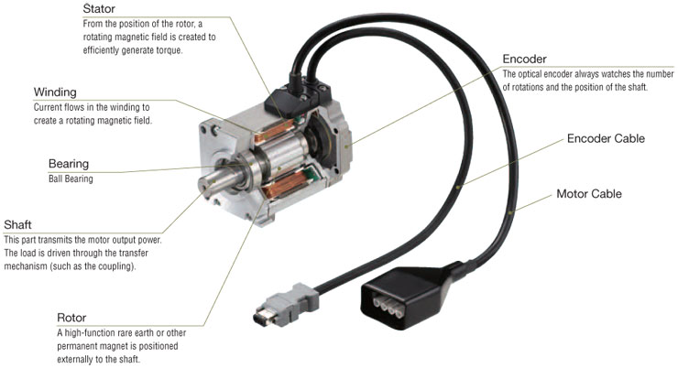
Topic – Servo Motor
A servomotor is a rotary actuator or linear actuator that
allows for precise control of angular or linear positions,
velocity and acceleration.
Main components:
- Electric motor
- Feedback device
Electronic controller
Different types of Servo Motors:
- AC servo motor
- DC servo motor
- Continuous rotation servo motor
Linear servo motor
Servo Drive:
- Electronic amplifier used to power electric
servomechanisms.

Slide 9
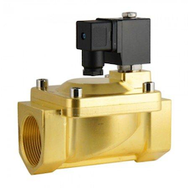
Topic – Solenoid Valve
Solenoid valve –
Solenoid valves are control units which, when electrically
energized or de-energized, either shut off or allow fluid flow.
Components of solenoid valve -
- Solenoid coil
- Cylinder
- Plunger
- Spring
- Main body
- Inlet port
Outlet port
Types of Solenoid valve –
- Normally closed
- Normally open

Slide 10
THANK YOU
Atharva Londhe Div: D3
Enrollment No. - 1904081

